Slide 1
INTERNSHIP PRESENTATION
BY SNEHA PANTAM AND SREENATH MADUPOJU

Slide 2
MOBILE APP
FRONT- END
MIDDLEWARE
BACKEND

Slide 3
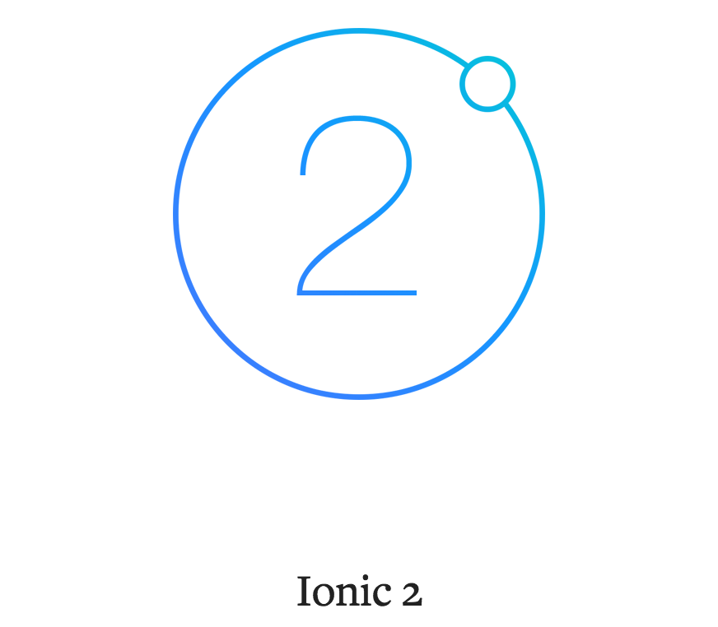
FRONT END
THE FRAMEWORK USED FOR FRONT END IS IONIC 2 ALONG WITH ANGULAR 2.

Slide 4
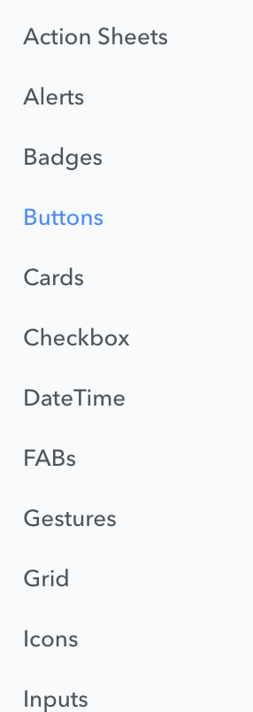
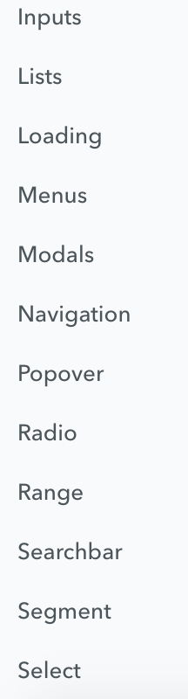
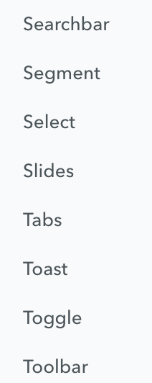
THE COMPONENTS OF IONIC 2

Slide 5
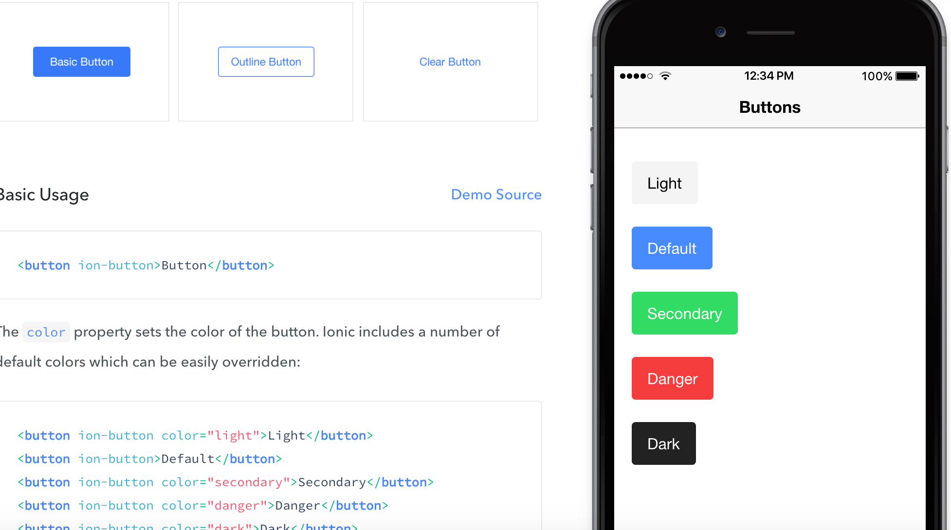

Slide 6
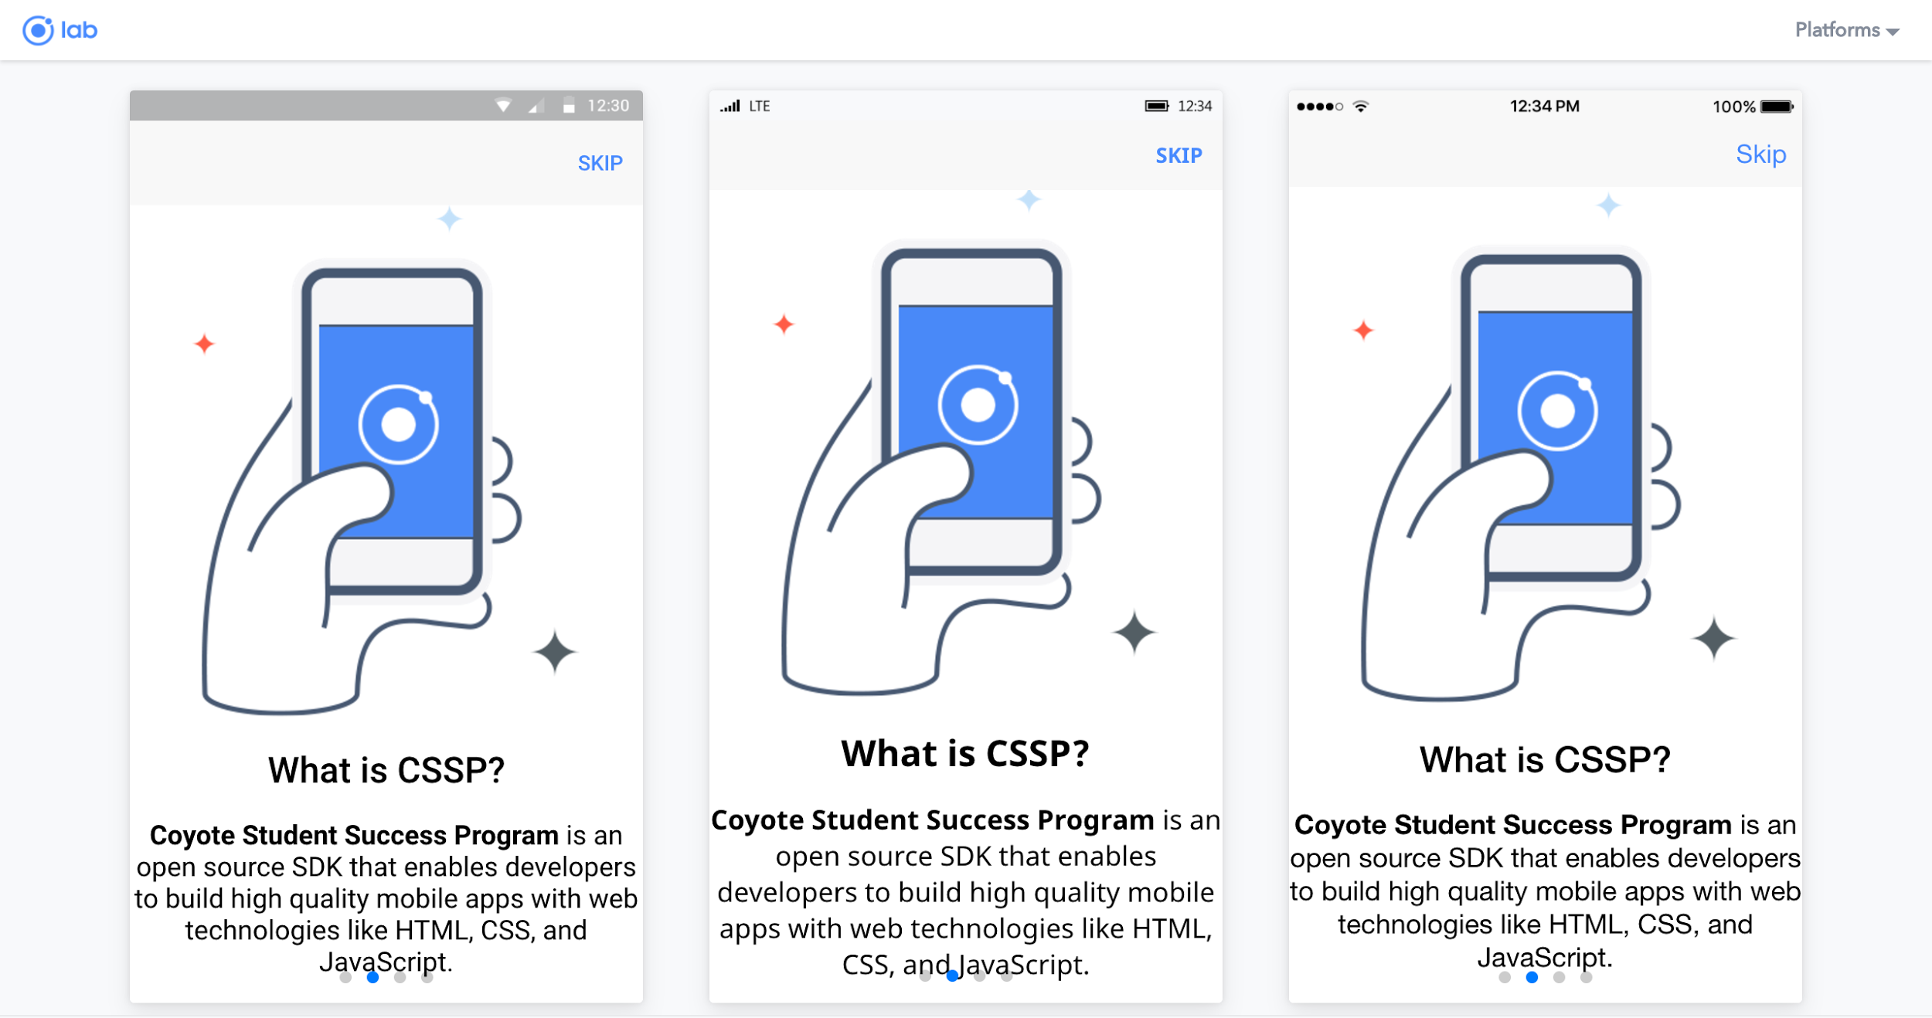

Slide 7
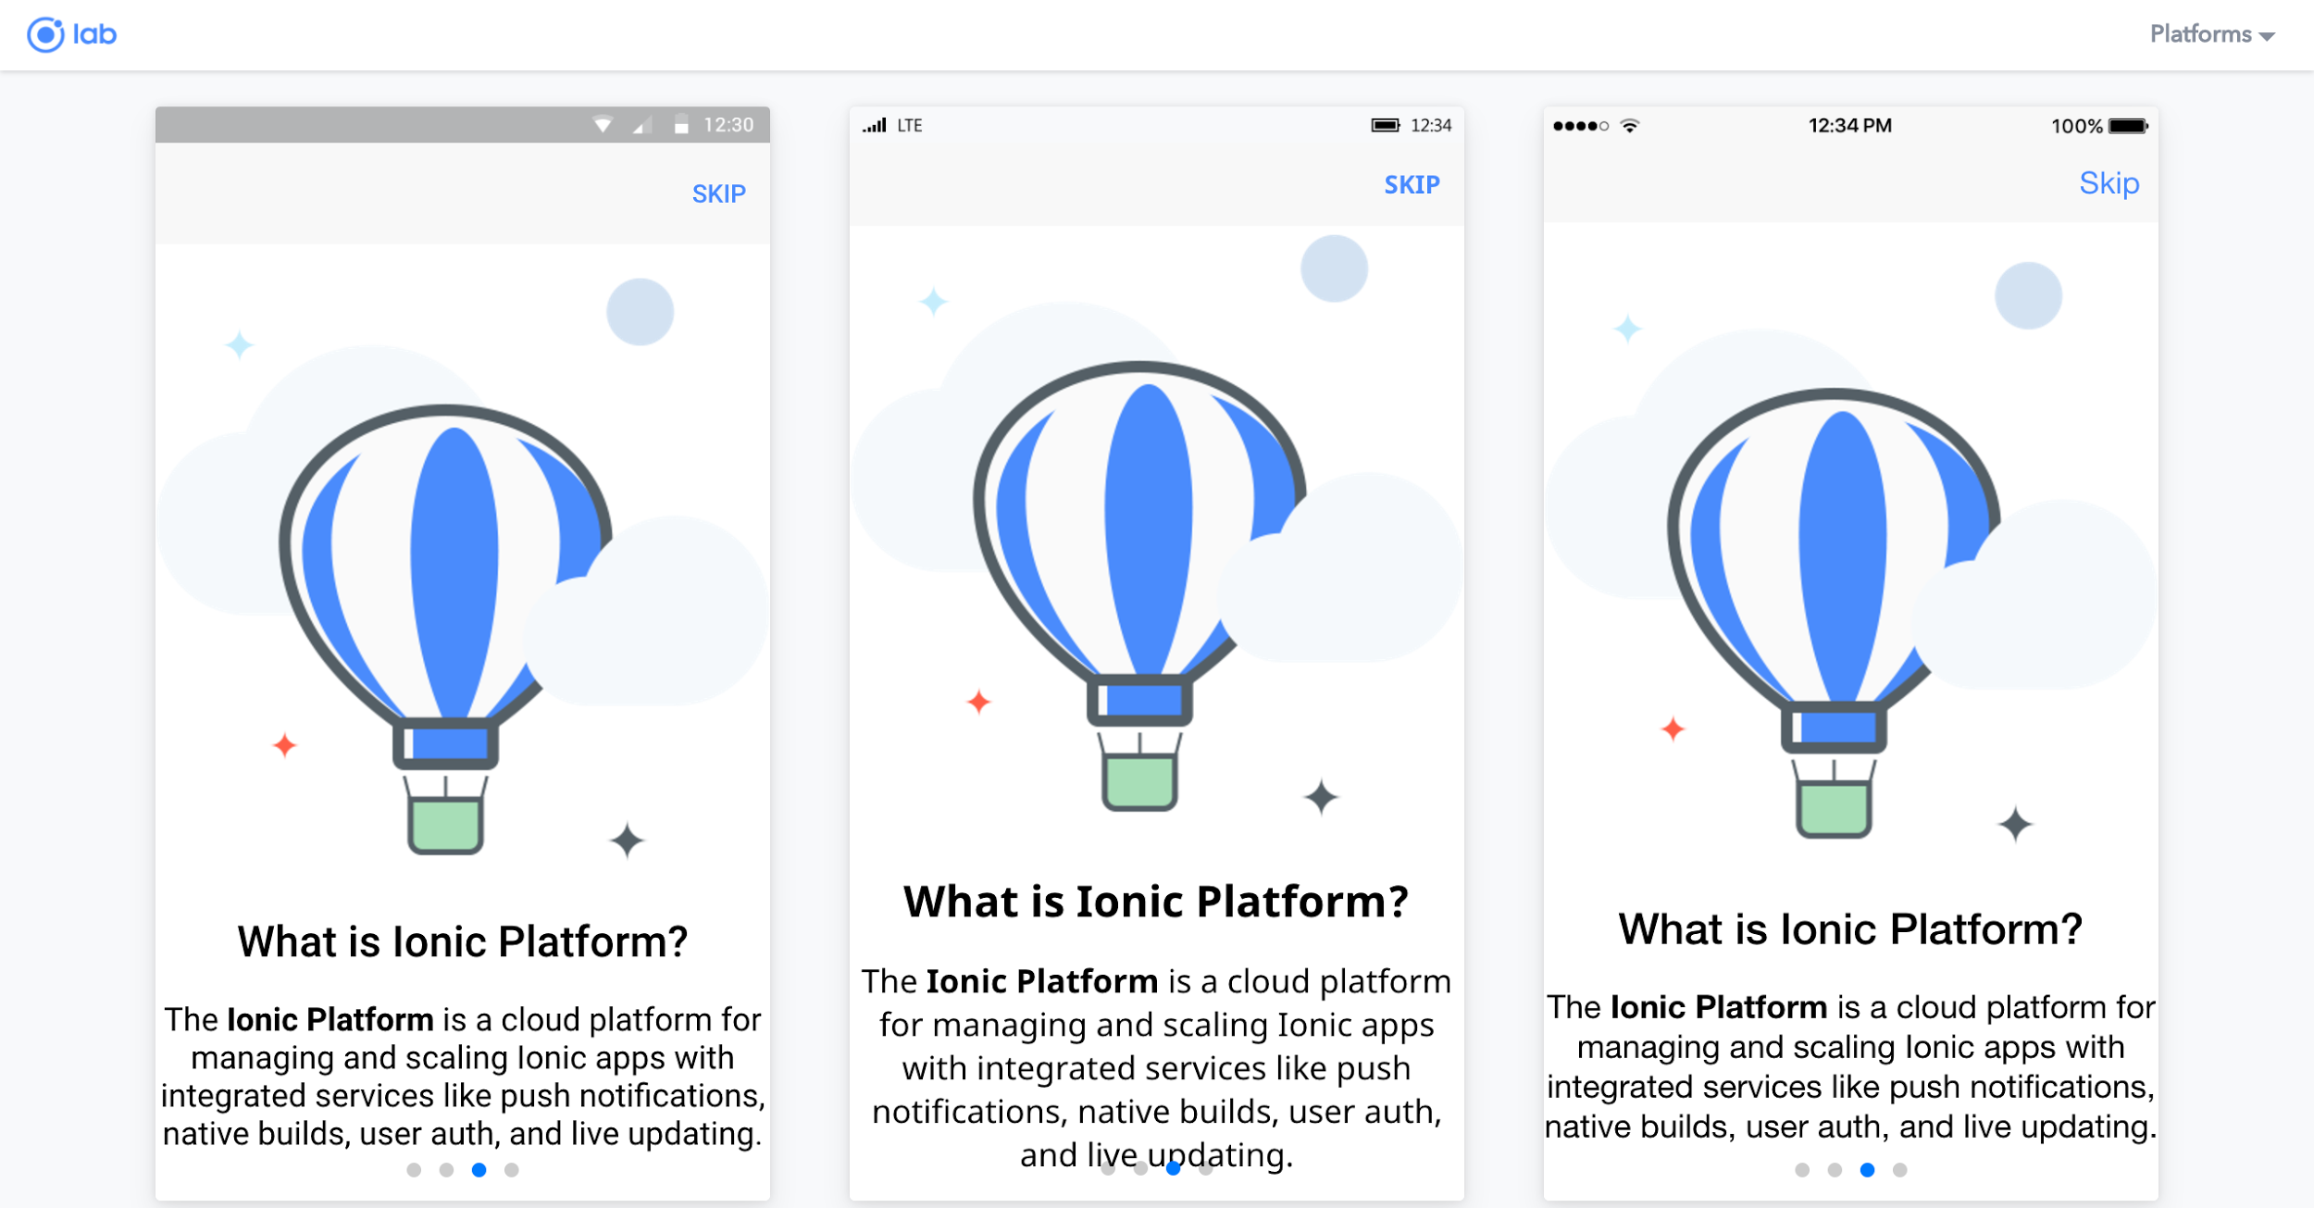

Slide 8
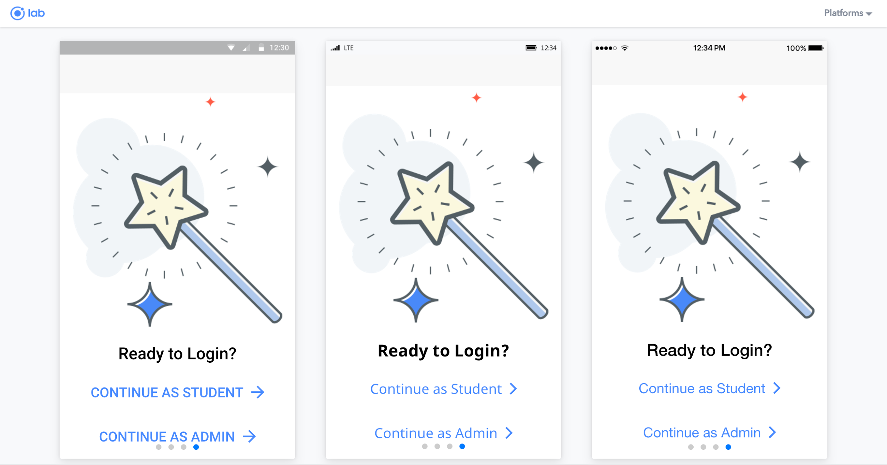

Slide 9
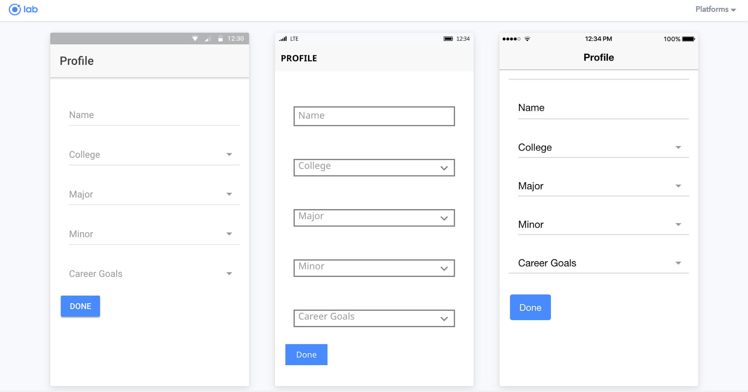

Slide 10
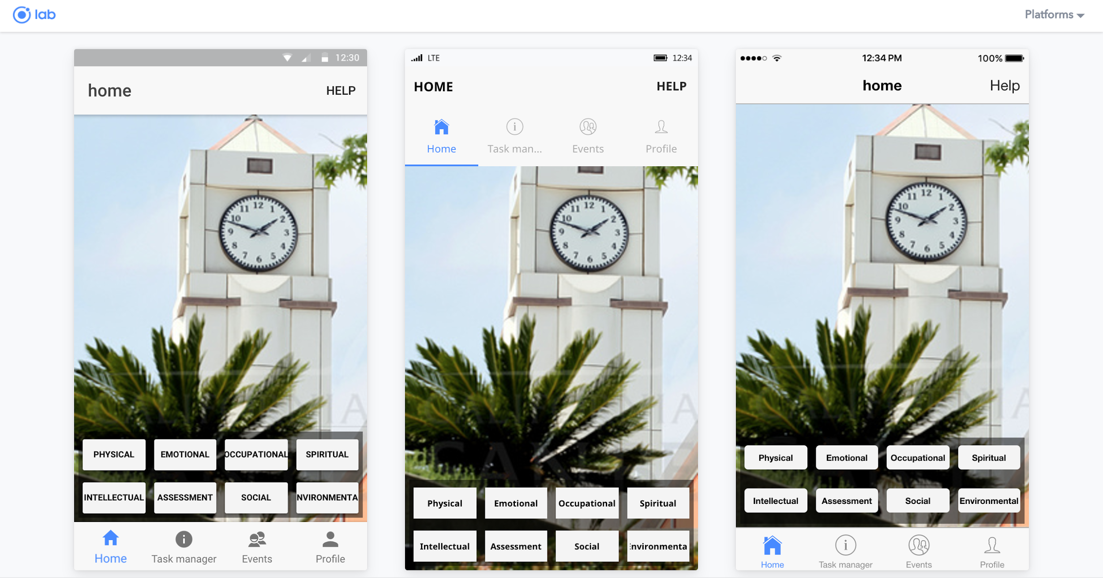

Slide 11
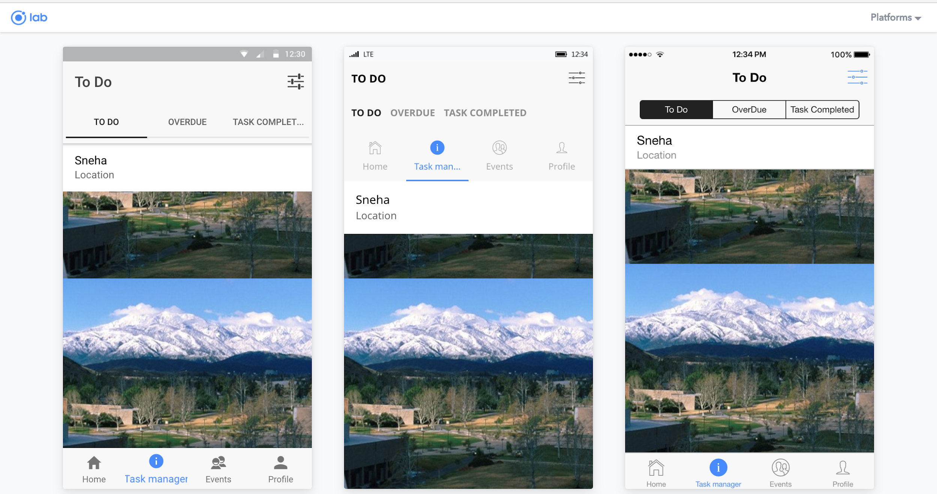

Slide 12
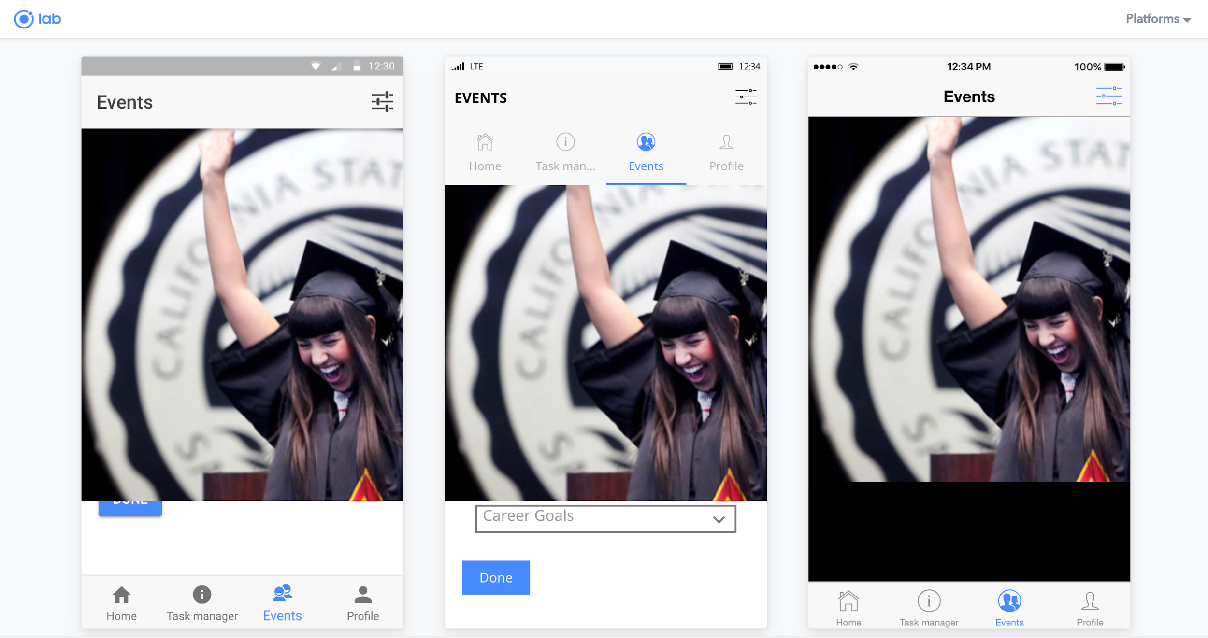

Slide 13
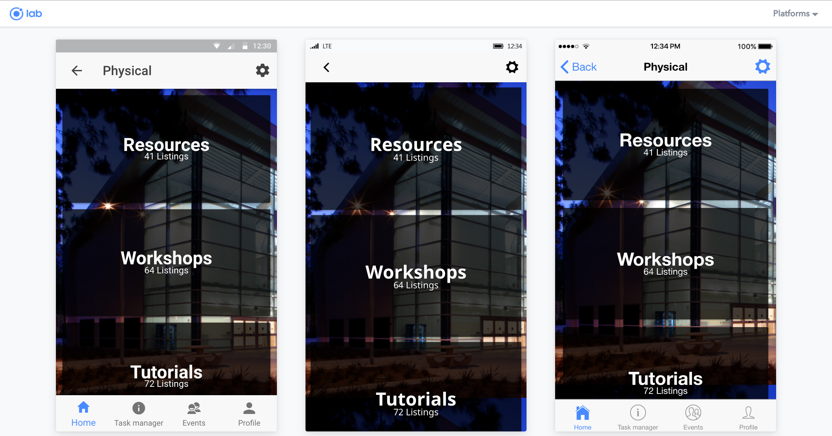

Slide 14
